Slide 1
Chapter 7
Rapid and Evolutionary Development

Slide 2
Evolutionary development - definition
“Evolutionary systems development is a staged or incremental approach that periodically delivers a system that is increasingly complete (i.e. it evolves) over time, it is sometimes termed incremental development”

Slide 3
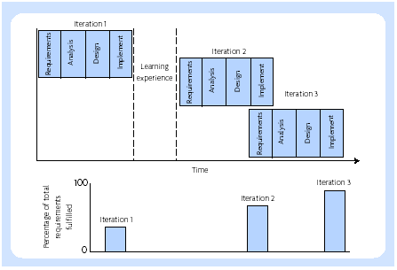
Evolutionary development

Slide 4
Gearing to evolution
The design does not have to be perfect - the first design often focuses on the core of the system
It can allow or accommodate future change, or at least not impede such change - by building in some flexibility or redundancy
It does not have to be comprehensive - only address part of the required system to begin with rather than everything that might possibly be required

Slide 5
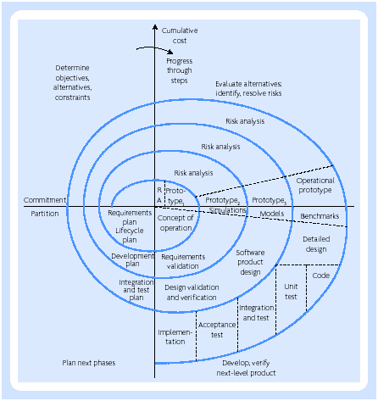
Spiral model (Boehm, 1988)

Slide 6
Prototyping
A throwawy (or expendable) prototype
An evolutionary prototype

Slide 7
Throwaway prototype
Inefficient for operational use
Incomplete, performing only some of the required tasks
Inadequate, sometimes being designed for one type of user or one purpose only
Poorly documented
Unsuitable, or difficult to integrate with other operational systems
Incapable of scaling to the required volumes of operational use

Slide 8
Justification for prototyping
The application area is not well defined
The organisation is not familiar with the technology (hardware, software, communications, designs and so on) required for the application
The communications between analysts and users are not good
The cost of rejection by users would be very high and it is essential to ensure that the final version has got users’ needs right
There is a requirement to assess the impact of prospective information systems. Inadequate, sometimes being designed for one type of user or one purpose only

Slide 9
Justification for prototyping
functional prototypes - for demonstrating, testing, and evaluating the functionality of a system
process prototypes - for demonstrating, testing, and evaluating the processes, sequences responses, etc. of a system
design prototypes - for demonstrating and evaluating a variety of alternate designs or solutions
performance prototypes - for testing response times, loads, volumes, etc
organizational prototypes - for demonstrating and evaluating different organizational designs, cross-functional work, organizational processes, and their integration with information systems

Slide 10
Justification for prototyping
Prototyping would be beneficial where:
  Requirements are unclear
  Requirements are unstable
  Innovativeness is high
  System impact is high on the organization
  System impact is high on users
  Project size is relatively small
  Number of users is relatively small
  Project duration is relatively short
  Commitment of users to a project is required

Slide 11
Prototyping in ISD
An analysis phase designed to understand the present system and suggest the functional requirements of an alternative system
A prototyping phase to construct a prototype for evaluation by users
A set of evaluation and prototype modification stages
A phase to design and develop the target system using the prototype as part of the specification

Slide 12
Rapid Application Development (RAD)
Incremental development
Timeboxing
The pareto principle
MoSCoW rules
JAD workshops
Prototyping
Sponsor and champion
Toolsets

Slide 13
MoSCoW Rules
M = ‘the Must Haves’. Without these features the project is not viable, i.e. these are the minimum critical success factors fundamental to the projects success
S = ‘the Should Haves’. To gain maximum benefit these features will be delivered but the projects success does not rely on them.
C = ‘the Could Haves’. If time and resources allow these features will be delivered but they can easily be left out without impacting on the project.
W = ‘the Won't Haves’. These features will not be delivered. They can be left out and possibly, although not necessarily, be done in a later timebox

Slide 14
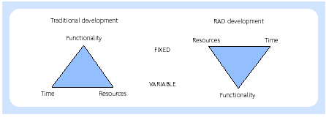
Traditional development

Slide 15
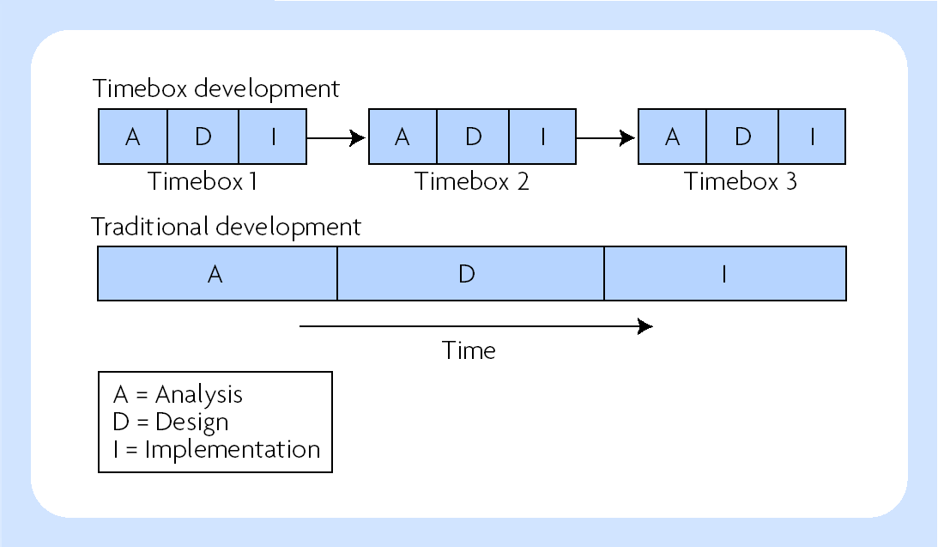
Comparison of timebox development and traditional development

Slide 16
Agile development
Philosophy of agile manifesto (Beck et al., 2001):
  Individuals and interactions over processes and tools
  Working software over comprehensive documentation
  Customer collaboration over contract negotiation
  Responding to change over following a plan

Slide 17
Principles of agile manifesto
The highest priority is to satisfy the customer through early and continuous delivery of valuable software.
Changing requirements are welcome, even late in development. Agile processes harness change for the customer’s competitive advantage.
Working software is delivered frequently, from a couple of weeks to a couple of months, with a preference to the shorter timescale.
Business people and developers must work together daily throughout the project.
Projects should be built around motivated individuals. If the right environment and support is provided, the developers can be trusted to get the job done.
The most efficient and effective method of conveying information to and within a development team is face-to-face conversation

Slide 18
Principles of agile manifesto (continue)
Working software is the primary measure of progress.
Agile processes promote sustainable development. The sponsors, developers, and users should be able to maintain a constant pace indefinitely.
Continuous attention to technical excellence and good design enhances agility.
Simplicity, the art of maximizing the amount of work not done, is essential.
The best architectures, requirements, and designs emerge from self-organizing teams.
At regular intervals, the team reflects on how to become more effective, then tunes and adjusts its behaviour accordingly.

Slide 19
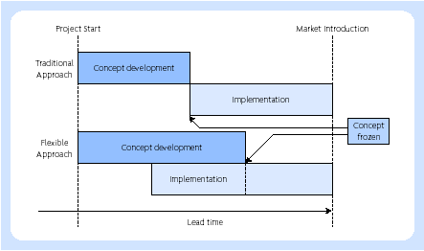
Approaches to new product development (Iansiti and MacCormack, 1997)

Slide 20
Agile approaches characteristics (Miller, 2001)
Modularity on the development process level
Iterative, with short cycles enabling fast verification and corrections to be made
Time bound, with iteration cycles from one to six weeks
Parsimony in the development process removing all unnecessary activities
Adaptive with possible emergent new risks
Incremental process approach that allows functioning applications to be built in small steps
Convergent approach to minimize risks
People oriented, i.e. agile processes favour people over processes and technology
Collaborative and communicative working style

Slide 21
Focus of agile approaches
Iteration
Short life cycles
Minimalism
Emergence
Risk acceptance
People orientation
Collaboration and communication

Slide 22
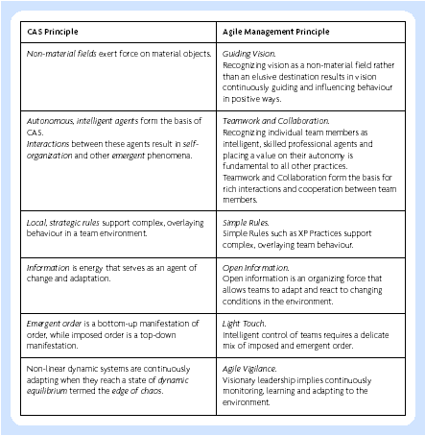
Agile and CAS (Complex Adaptive Systems) compared (Augudtine and Woodcock, 2003)

Slide 23
Web-based development
Web-based development concepts (Baskerville and Pries-Heje, 2001):
  Time pressure
  Vague requirements
  Prototyping
  Release orientation
  Parallel development
  Fixed architecture
  Coding your way out
  Quality is negotiable
  Dependence on good people
  Need for structure

Slide 24
Difference between Internet projects and traditional IS development
Internet time. The development time is reduced greatly – two years is unthinkable, 6 months is often unacceptable and many significant e-commerce projects are implemented in weeks.
Strategic implications. The strategic implications are directly related to business goals, particularly in e-commerce projects where a revenue stream is generated.
Emphasis on graphical user interface. There is a need for talented graphic designers to work with software engineers.
Customer-orientation. The user is a customer rather than an employee. E-commerce applications need customer focus and marketing input.

Slide 25
Similarities between Internet projects and traditional IS development
Databases - sophisticated Internet applications rely on databases and require traditional software engineering skills to implement them.
Integration - internet applications need to be integrated with enterprise applications. E.g., a car ordering system that gives consumers a delivery date needs to communicate with manufacturing requirements planning (MRP) software. Enterprise Application Integration (EAI) is a challenge for Internet applications.

Slide 26
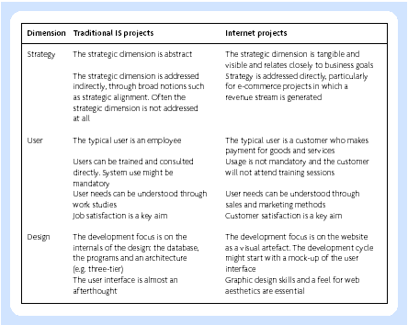
Traditional and internet based applications (from Vidgen, et al., 2002)

